Slide 1
General Qualities of Literature
17th century literature is largely melancholic. The literature of the period is centred in London

Slide 2
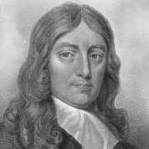
John Milton

Slide 3
Poetry
In the 17th century there were two schools of poetry
1- Metaphysical poetry
2- Cavalier poetry

Slide 4
The metaphysical poetry
They don’t have to use 14 lines. They use unusual or striking metaphors which unite unrelated things. These metaphors are called conceit.
These poems are either about love or religion. Love isn’t treated idealistically, but very erotic, very worldly. Religious poems don’t teach a lesson. The poets of these religious poems question themselves their own faith.

Slide 5
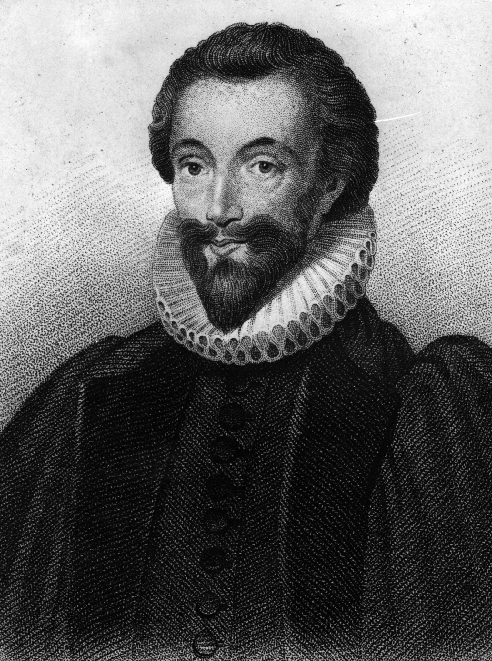
John Donne

Slide 6
Flea by John Donne
The work has been assigned to the students at the very first week of this term, and the students have been told that they must read the poem and participate in class discussion. So the students must read and study the poem.

